Slide 1

Project 4: Real World Dataset IE 6910 Python ML
By Mohammed Abdul Najeeb Farooqui

Slide 2
Energy Dataset

Slide 3
Exploring and Cleaning the dataset
In this part we will be looking at few of the data cleaning steps and the descriptive statistics of our data.

Slide 4
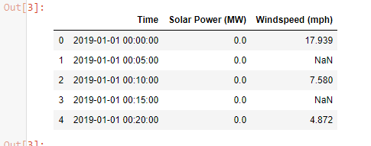
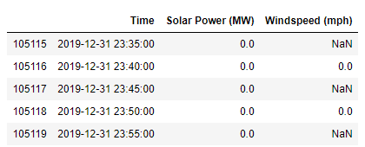
Looking at the shape head and tail of the dataset
We can see that we have 105120 rows in the dataset and we have 3 primary columns.
The three columns are Time, Solar Power (MW) and Windspeed.
Looking at head and tail of the dataset we find that there are mostly 0 values present in the solar power dataset and a lot of NaN values present.
The Nan values are present since the windspeed dataset is recorded for every 10 minutes and the solar power data is recorded every 5 min.
By looking at the tail of the dataset we can see that we have the data for the complete year of 2019

Slide 5
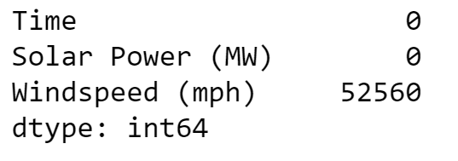
Check For missing values
A quick check for the missing values present in the dataset reveals to us that we have no missing values present in the Time Column and the Solar power column.
The only missing values that we have are in the Windspeed dataset and this is due to the fact that windspeed data is captured for every 10 minutes and solar power data is captured every 5 minutes.
A quick check as to how much percentage of the rows are missing from the windspeed column shows us that 50% of the rows are missing. Which was expected.

Slide 6
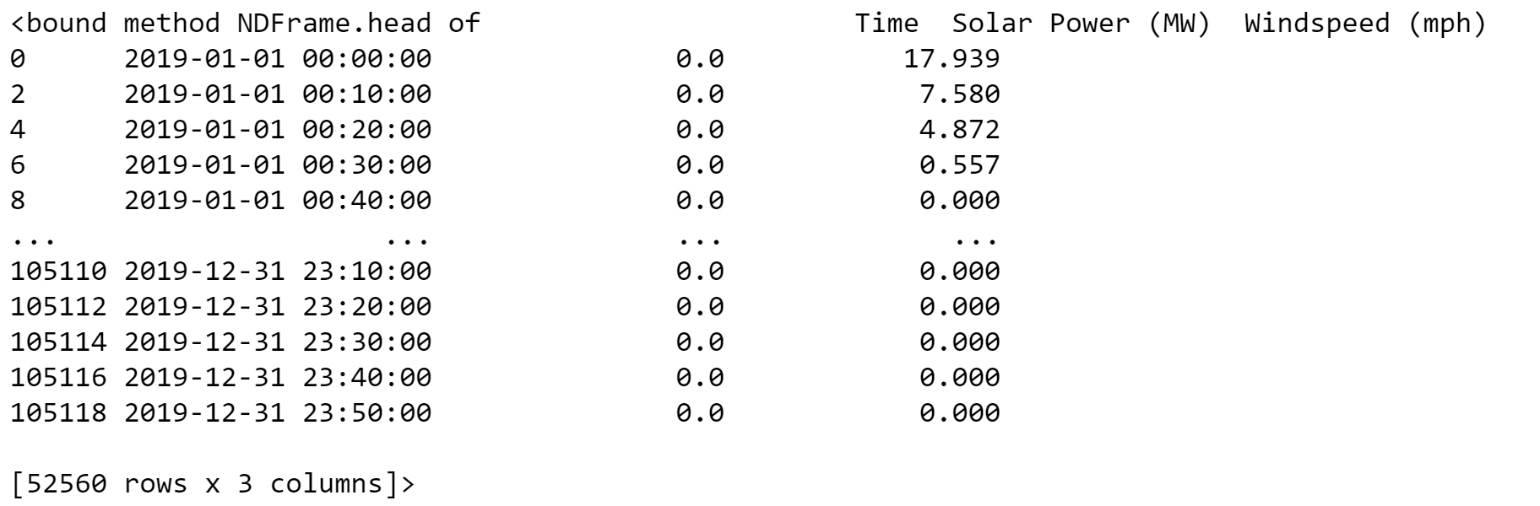
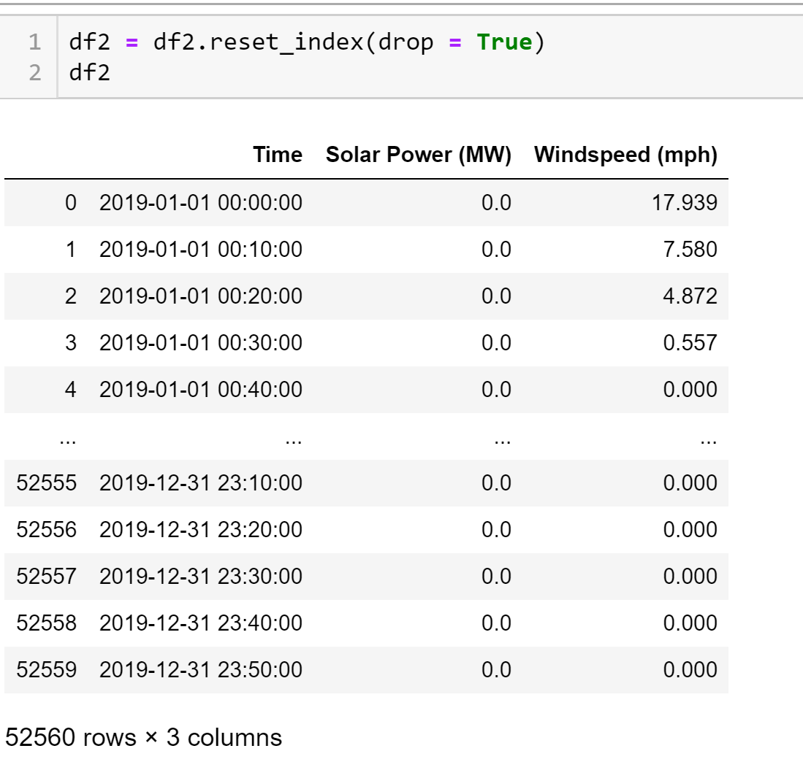
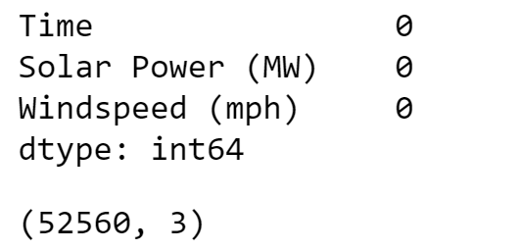
Treating for missing values
Missing columns treated
Since we have 1lakh rows of data available to us I choose to drop all the rows where we had missing values.
The new dataset that we will be working on looks like this.
We can see that the index has been set in the wrong order and we quickly reset it by using the below given code so that it is in the correct order.
We run a check once again for missing values and find that there are non present now.
Index reset
Check for missing values

Slide 7
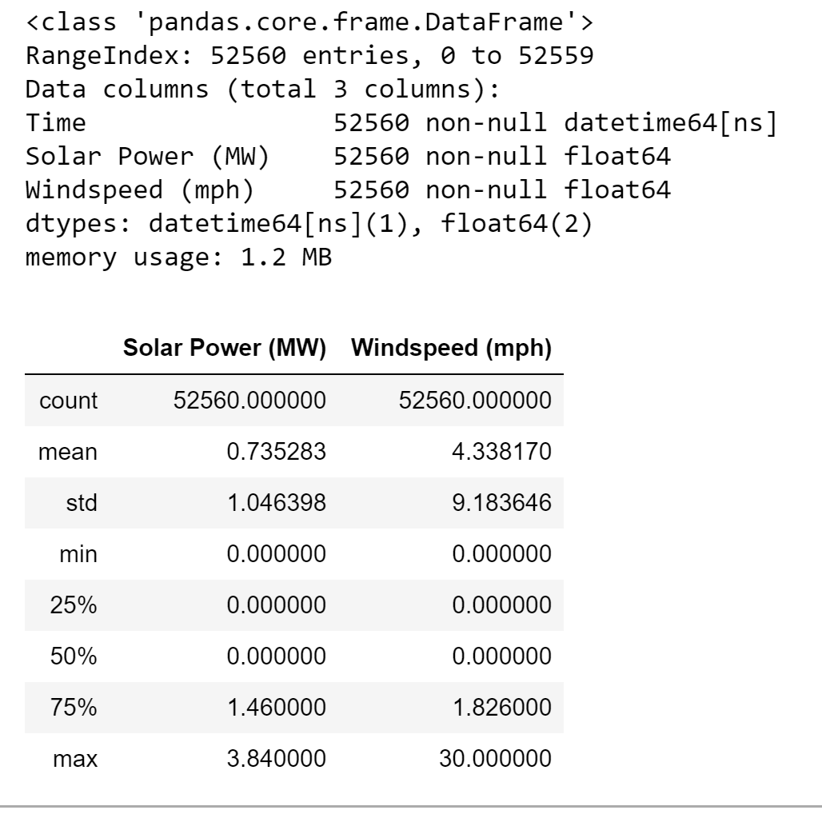
Looking at few descriptive statistics and data structure of the dataset
Column Class
We see that pandas already knows by default that we have a time column and parses it to a datetime64 class.
The rest two columns of solar and wind are of the numeric float64 format.
Besides data classes we can also look at other statistics for both the columns. We can see that we have very low values for solar power with less variation.
However on the other hand the standard deviation of windspeed tells us that there is a lot of variation present in the windspeed column.
Descriptive statistics

Slide 8
Data Visualization
In this section we will be looking at various plots of the dataset in order to deepen our understanding of it.

Slide 9
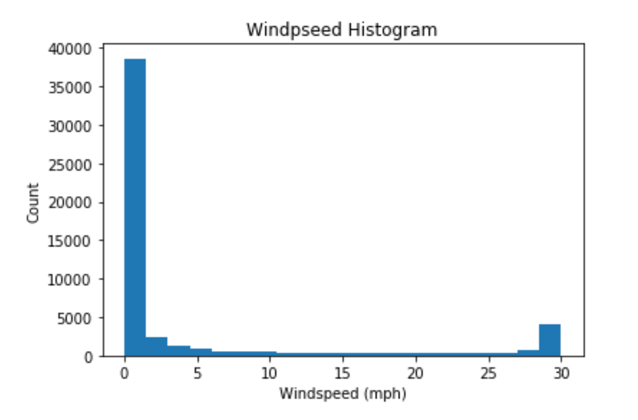
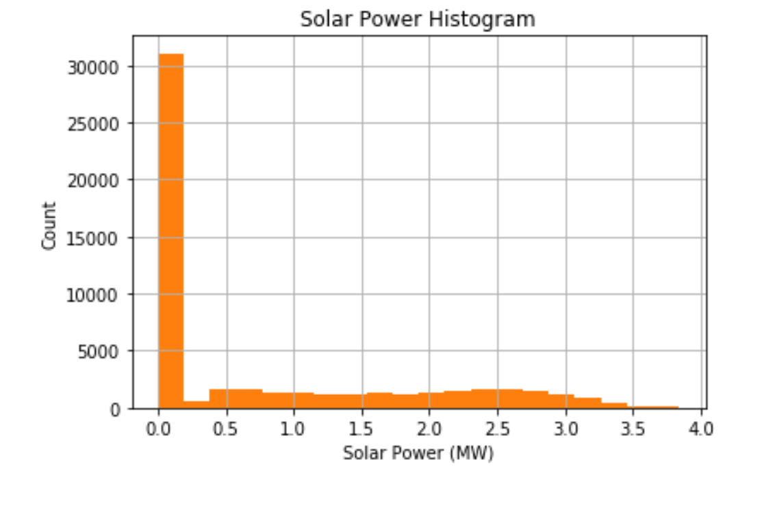
Histograms
We take a look at the distribution of windspeed and solar power data present in the column by creating a histogram plot.
We can clearly see that both the columns have been heavily dominated by the value 0. This must be because for the most part of the day the recordings at every 10 minutes don’t show a great deal of change in the value of windspeed or solar power.

Slide 10
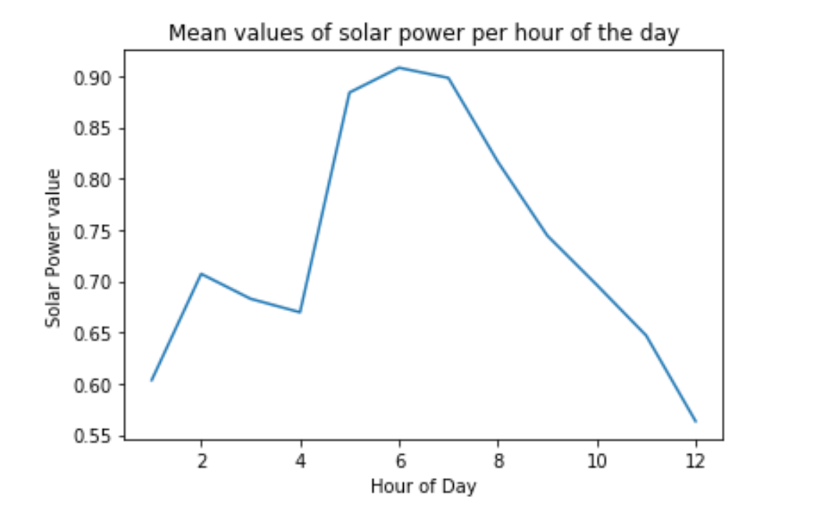
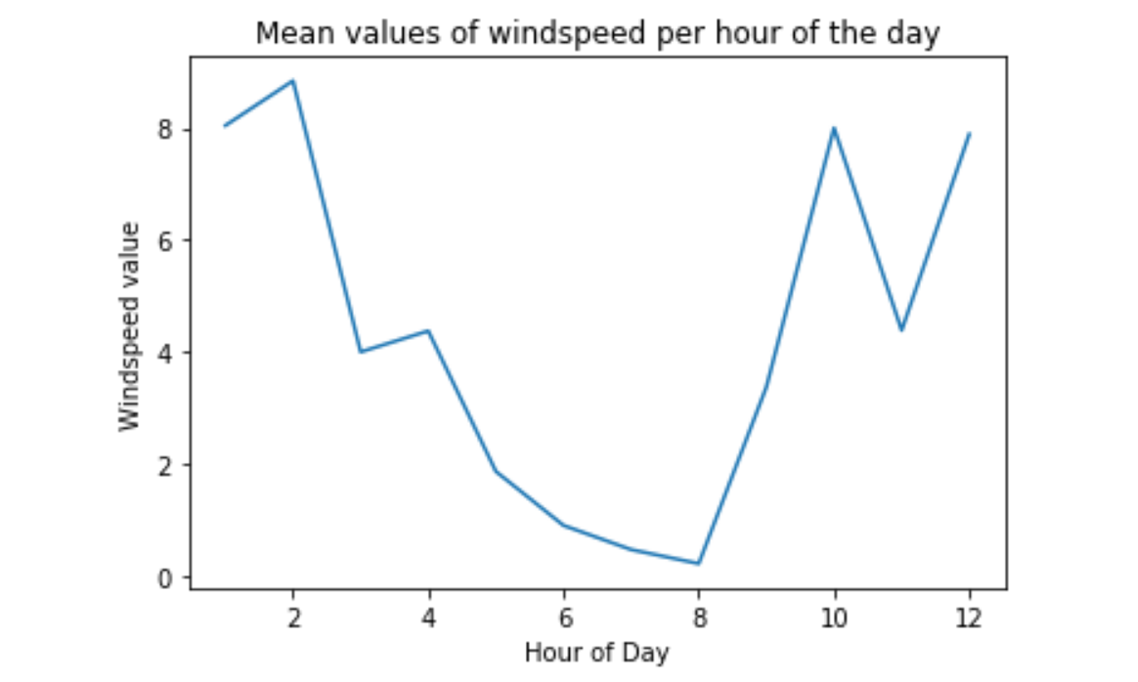
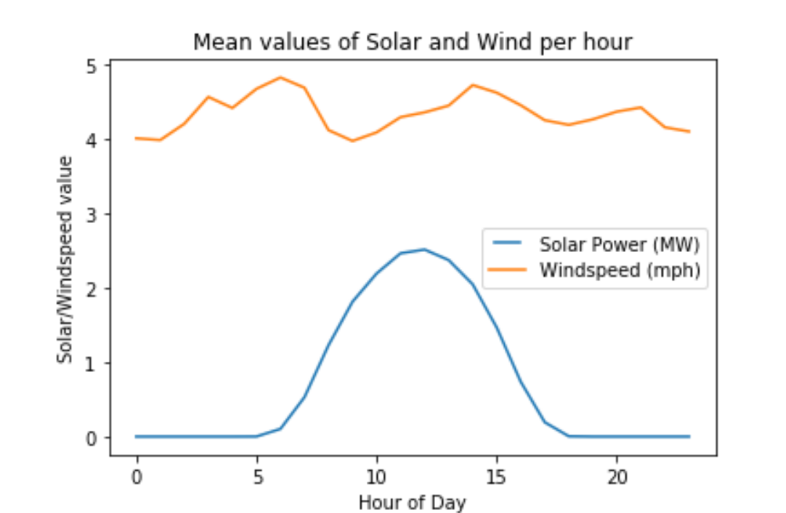
Line plot 1
We take a look at the mean values of windspeed and solar power per hour throughout the year.
The first plot on the right shows us the distribution for the mean value of solar power per hour. It shows us that the mean value of solar power generated increasing during the day which is expected as the sun is at it’s highest point during the day.
The second plot on the right shows us the distribution for mean value of windspeed per hour throughout the day. We can see that the windspeed reach highest during the night hours and stay relatively less during the day.
Final graph shows us both the plots plotted on the same y axis. We can observe no apparent connection between them from the graphs alone.

Slide 11
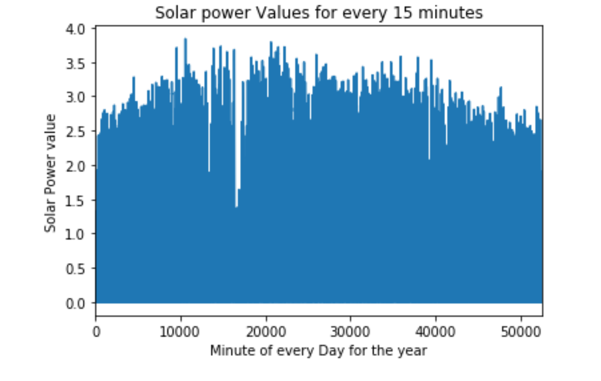
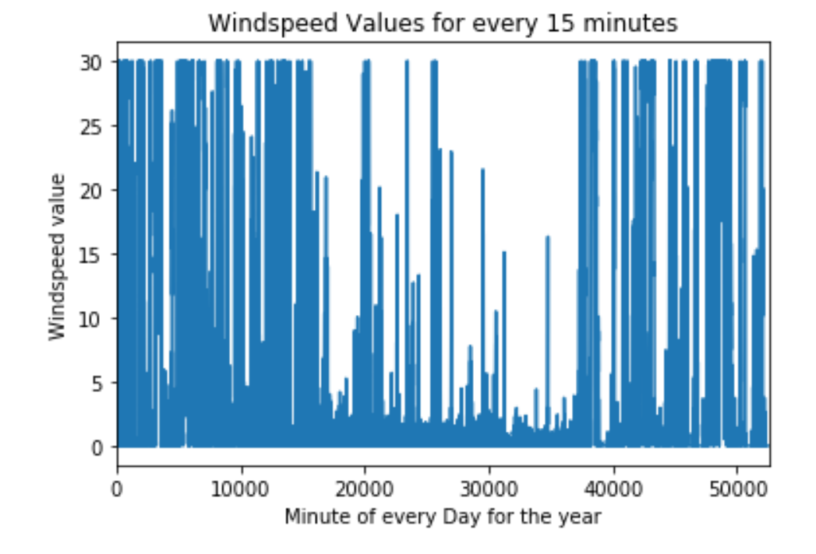
Line Plot 2
Next we take a look at all the values of the solar power and the windspeed plotted from the column as a line plot.
This line plot although doesn’t give us a lot of information but it shows us that there is a huge variation in the values of windspeed as compared to the values of solar power.

Slide 12
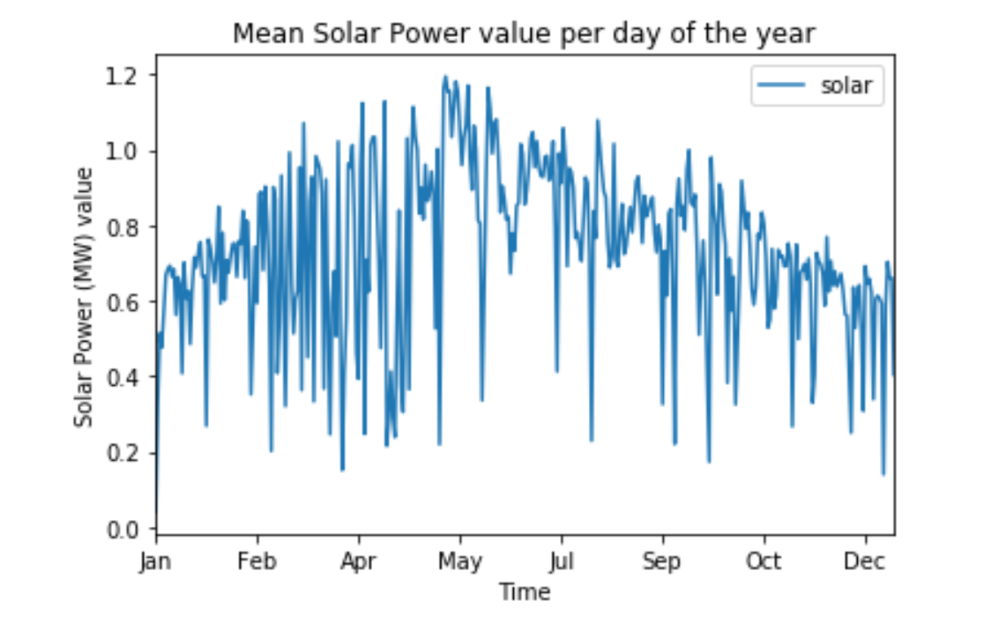
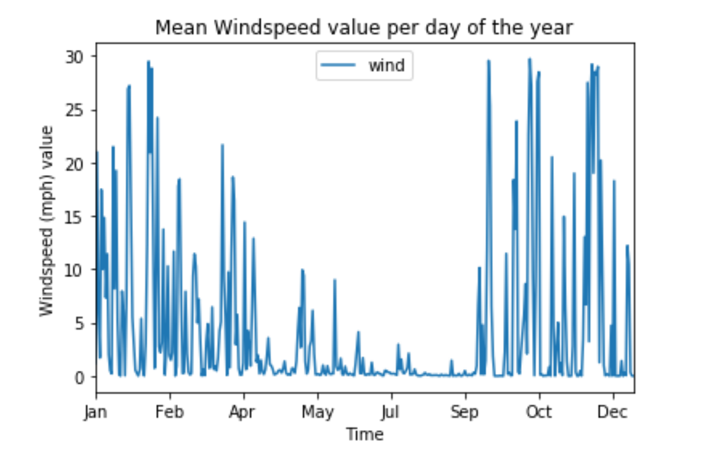
Line Plot 3
Next we take a look at the line plots for mean values of solar power and windspeed per day throughout the year.
This is an interesting plot since we can see a lot of trend values setup inside both of these plots.
I choose to create models that would allow us to predict mean values for both solar power and the wind power generated everyday.
If in case valuable information such as the mean value of solar power or wind speed could be predicted it would help meteorologists and other weather researchers in many ways.

Slide 13
Modeling and analysis
In this part of the ppt we will explore the various models created for analysis of the dataset and also choose the best one out.

Slide 14
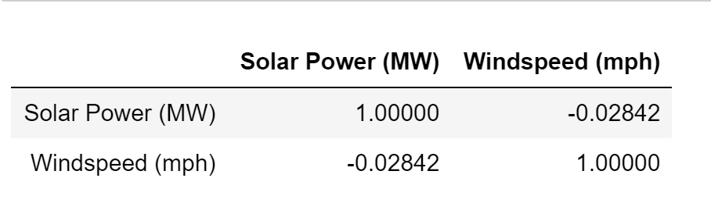
Linear Regression Modelling
I wanted to explore the possibility of creating a linear regression model to predict mean solar power generated in a day by using the windspeed variable as predictor or vice versa.
Upon analysis of correlation between the two columns I found out that they had little to almost no linear correlation amongst them, so I decided to abandon the idea of regression and moved towards forecasting models for this dataset.

Slide 15
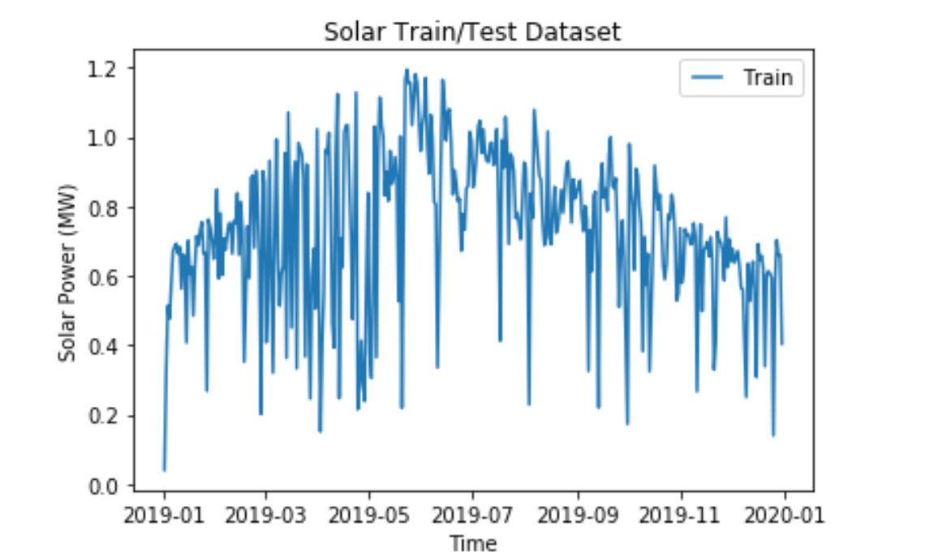
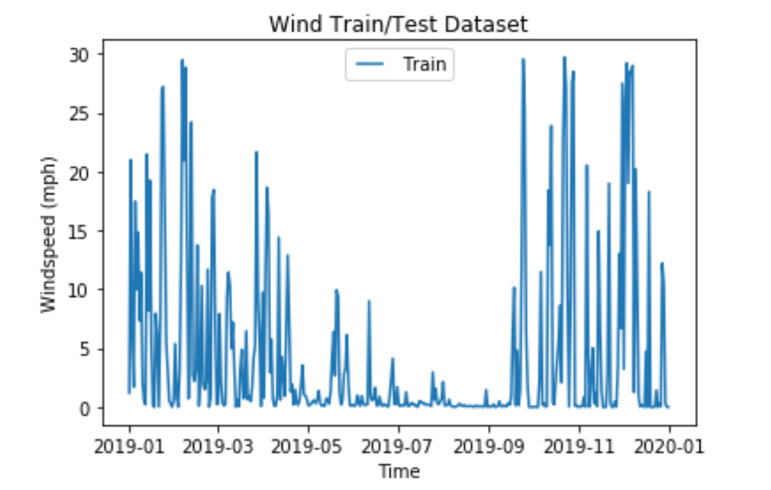
Training and testing dataset
The training dataset used for this model is the dataset given to us in the Energy.xlsx file, for the testing however I did not have another years data, so I decided to go with using the training dataset for testing as well.
Even though I realize that training and testing dataset could create biases but I figured that since solar power and windspeed phenomenon are seasonal they might be the same or similar for the most part at least throughout the next year as well.

Slide 16
Forecasting Models Built and Tested
Following forecasting models have been built and tested out for the dataset:
Autoregression
Moving Average
Autoregressive Moving Average
Autoregressive Integrated Moving Average
Seasonal Autoregressive Integrated Moving Average
Simple Exponential Smoothing
Holt Winter’s Exponential Smoothing
I have used the metric Root Mean Squared Error (RMSE) as the metric for deciding which models are better than the other.
Lower the RMSE, better the model.
The next few slides will contain the RMSE of each model tested on solar power test dataset and windspeed test dataset and a plot to visualize how well the model is doing when compared to the test set.

Slide 17
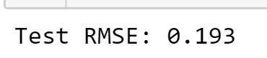
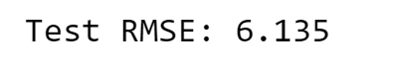
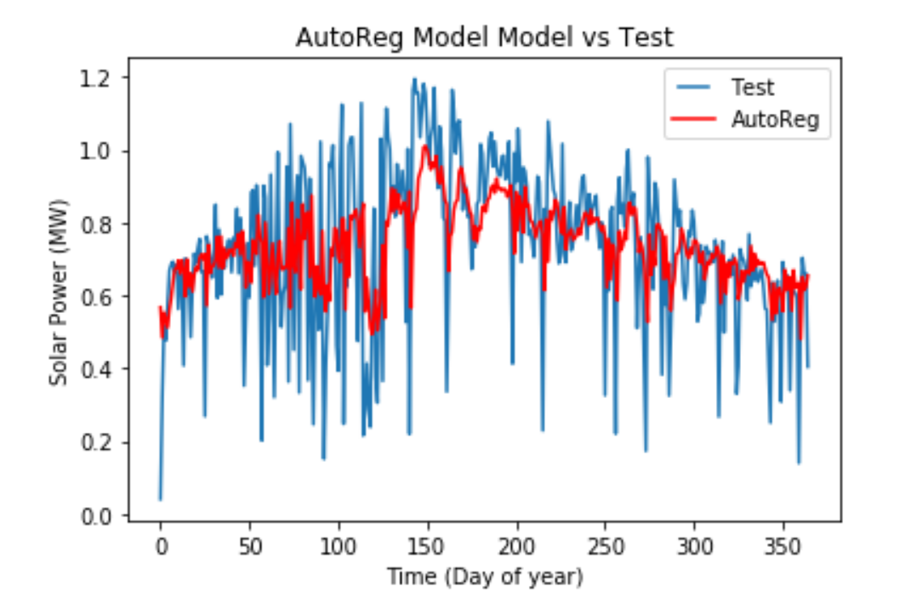
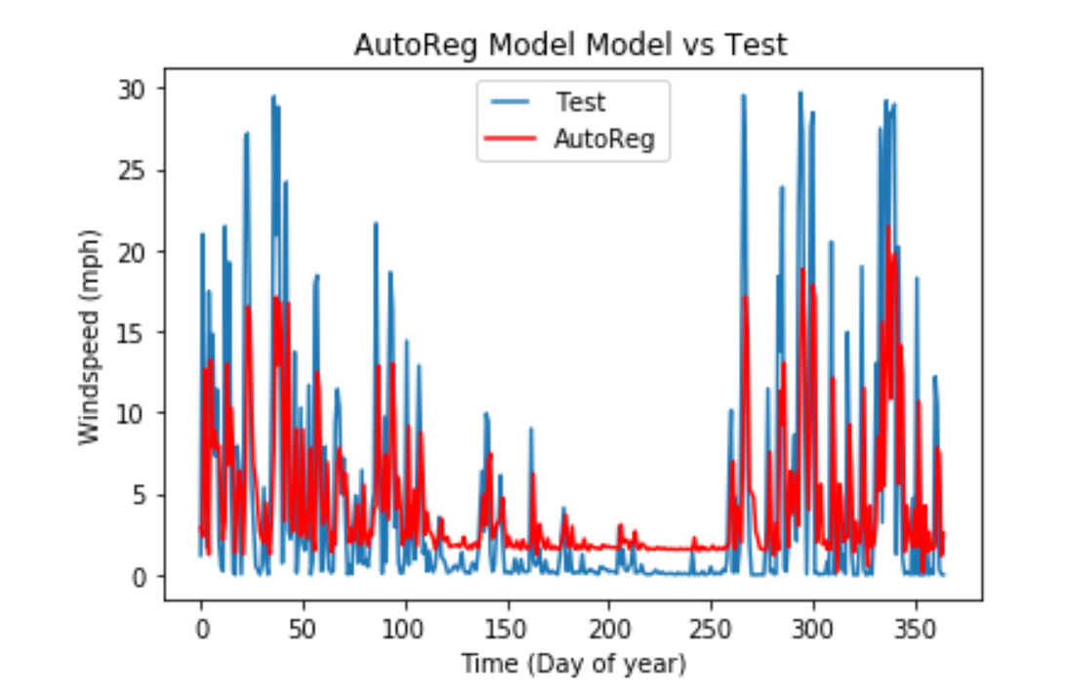
Autoregression (AR) Model
RMSE for solar power data
RMSE for windspeed data

Slide 18
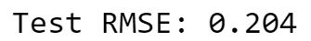
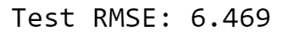
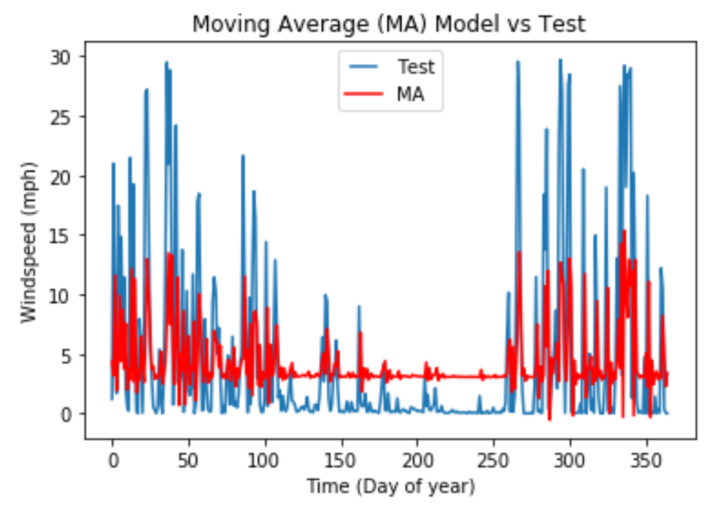
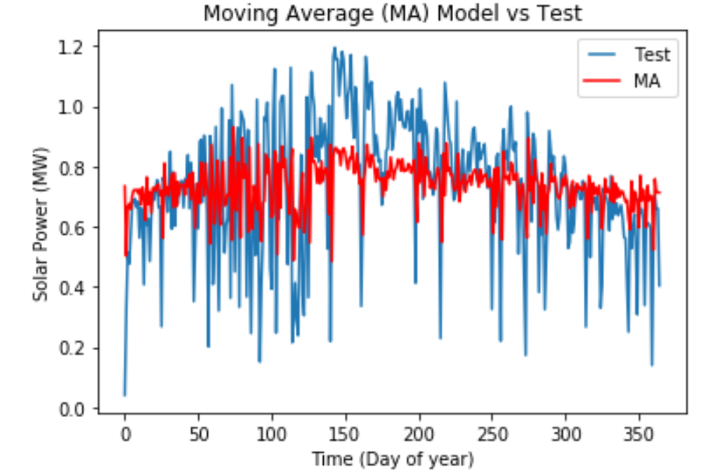
Moving Average (MA) Model
RMSE for solar power data
RMSE for windspeed data

Slide 19
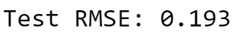
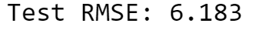
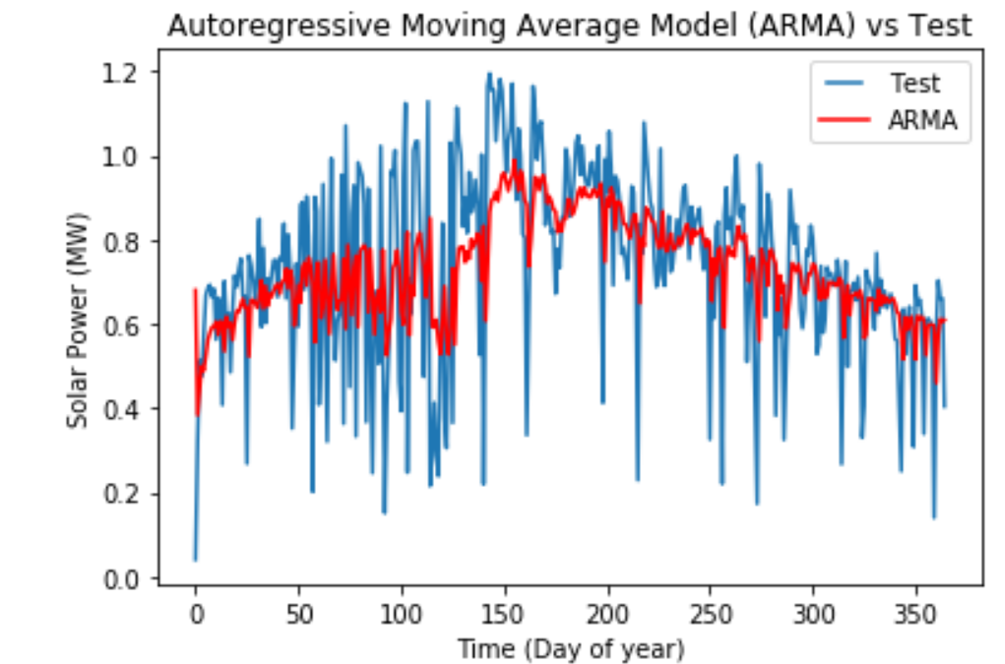
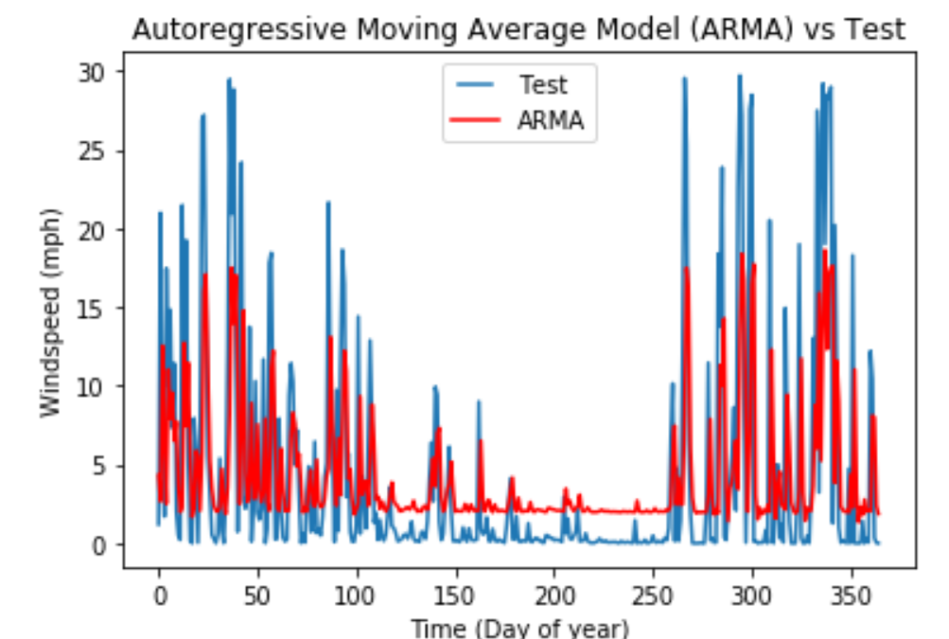
Autoregressive Moving Average (ARMA) Model
RMSE for solar power data
RMSE for windspeed data

Slide 20
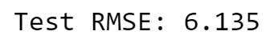
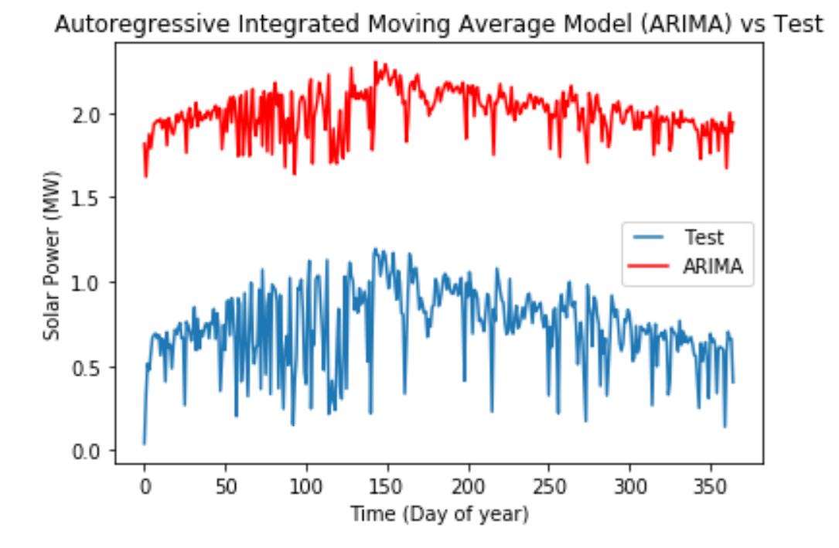
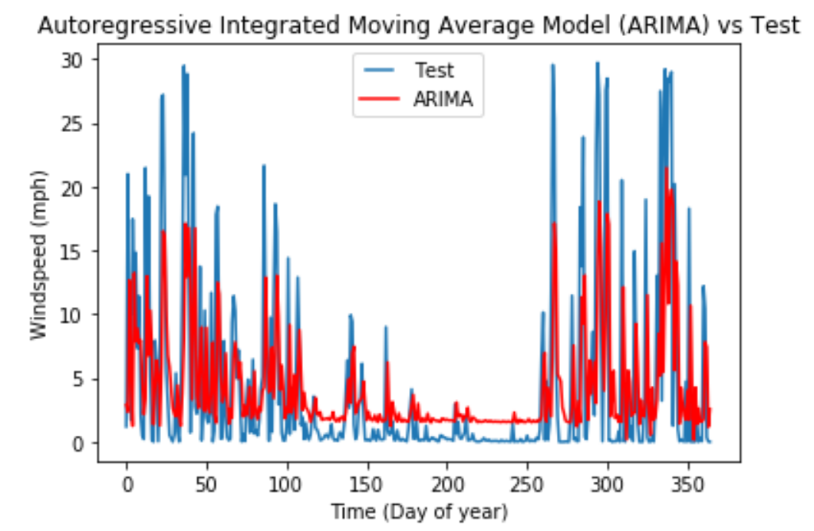
Autoregressive Integrated Moving Average (ARIMA) Model
RMSE for solar power data
RMSE for windspeed data

Slide 21
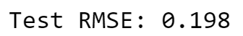
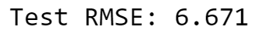
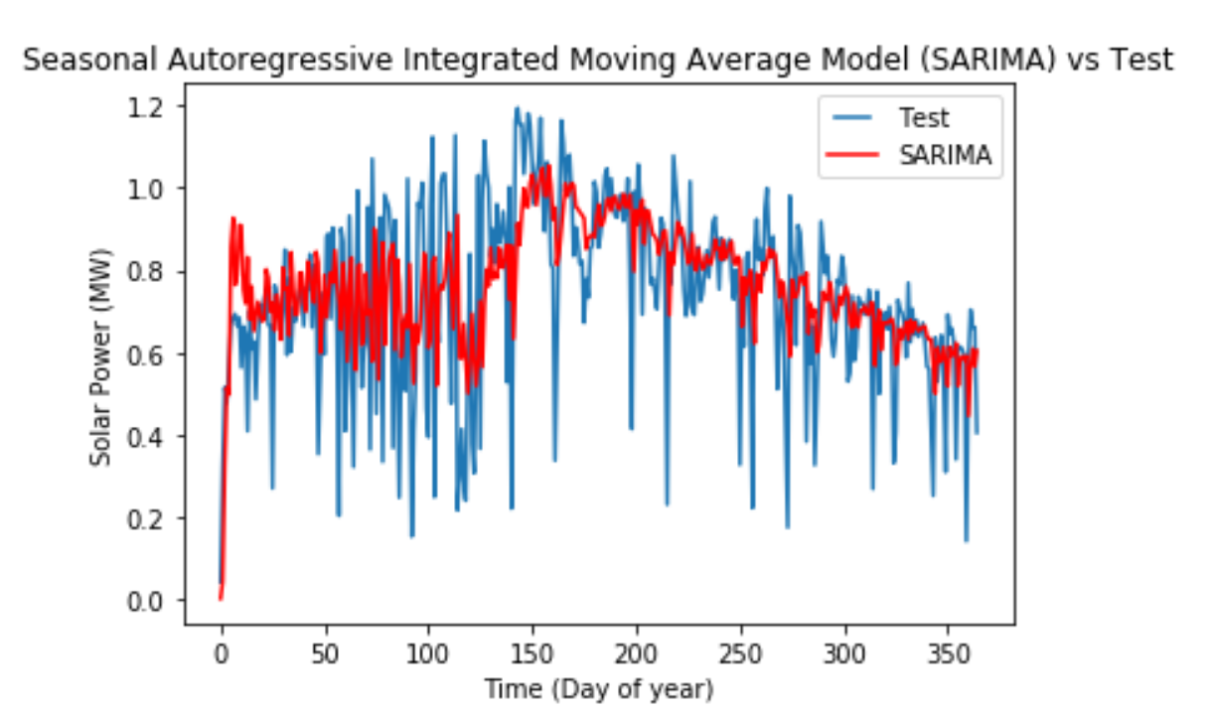
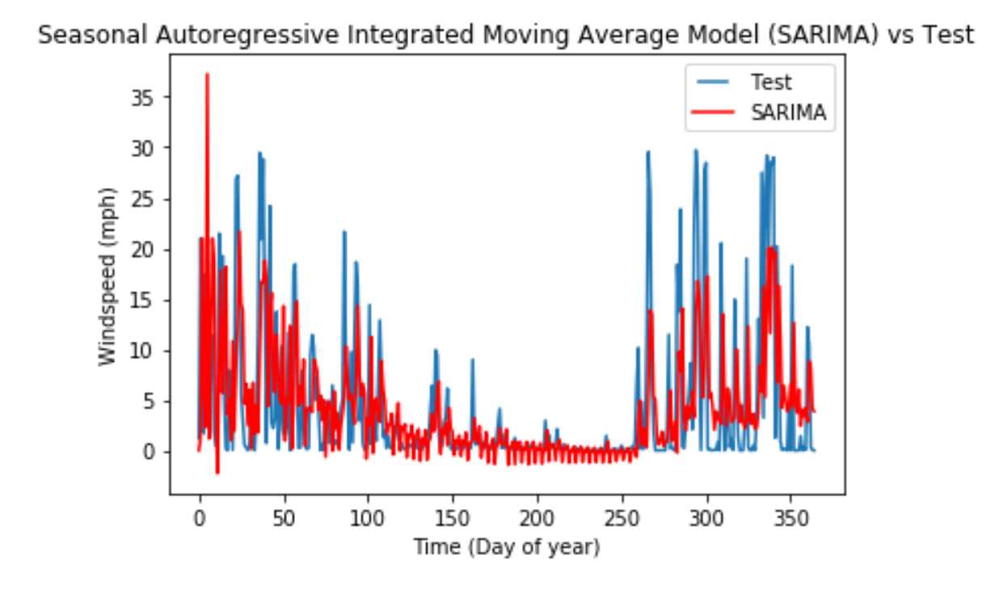
Seasonal Autoregressive Integrated Moving (SARIMA) Average Model
RMSE for solar power data
RMSE for windspeed data

Slide 22
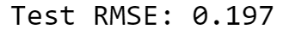
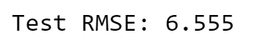
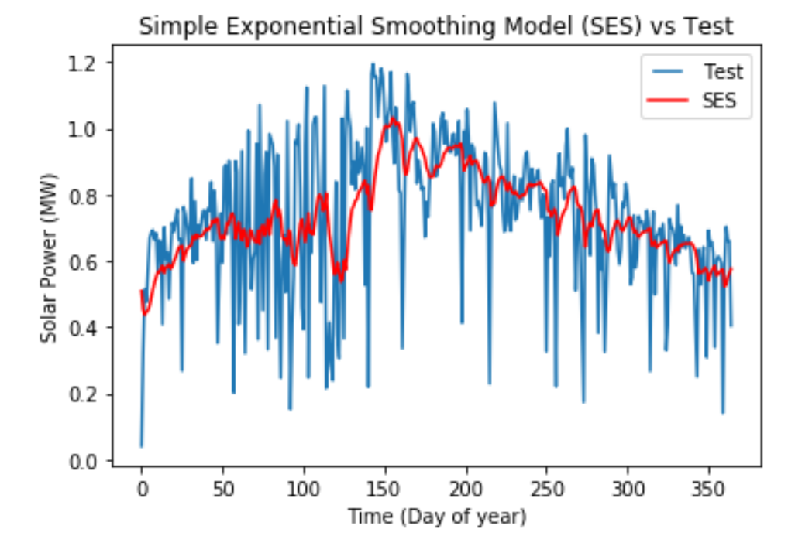
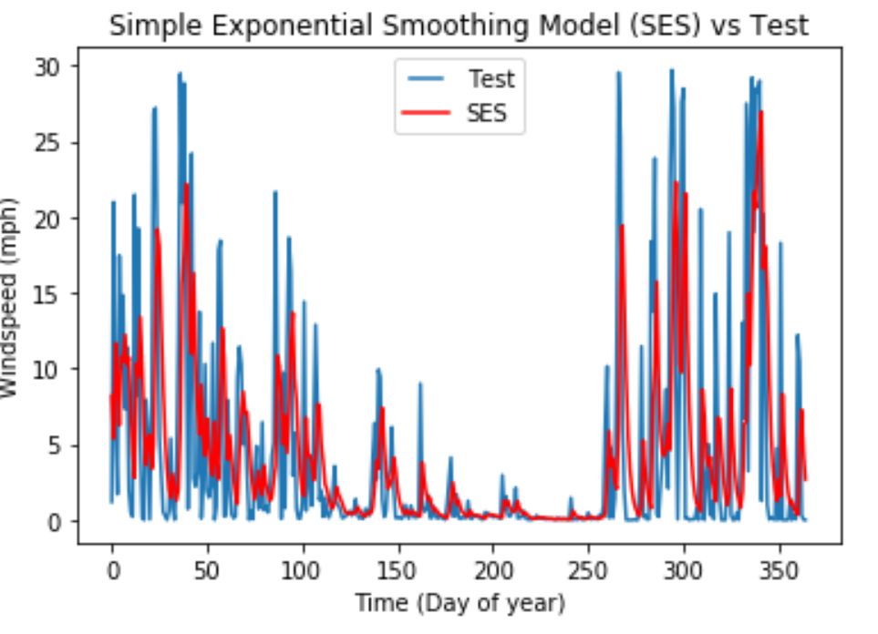
Simple Exponential Smoothing (SES) Model
RMSE for solar power data
RMSE for windspeed data

Slide 23
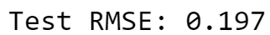
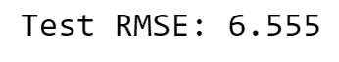
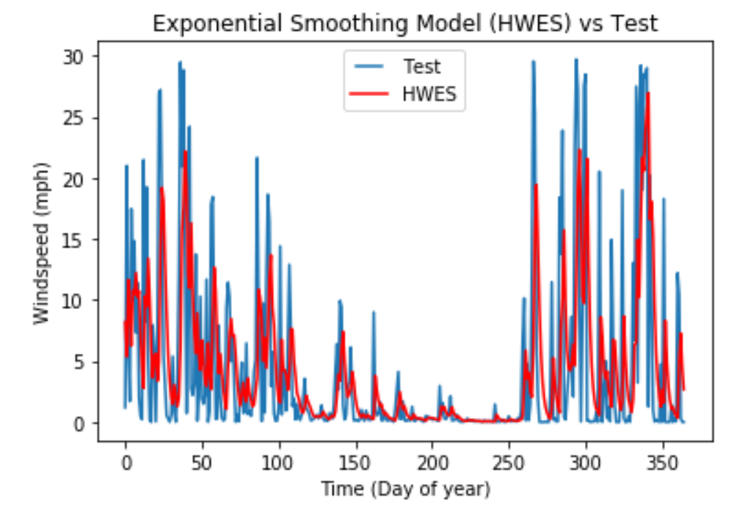
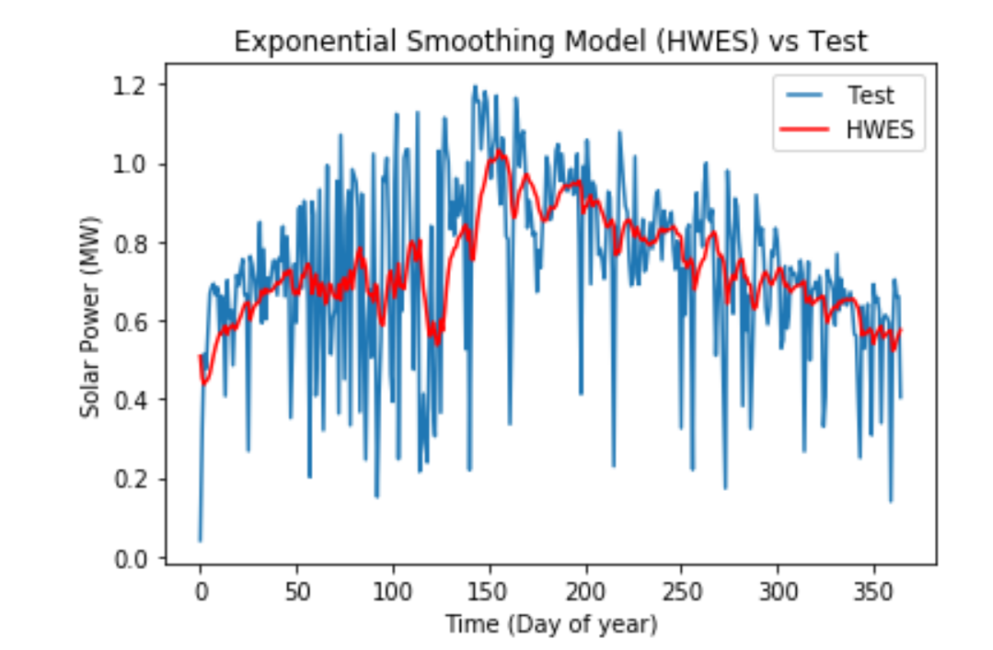
Holt Winter's Exponential Smoothing (HEWS) Model
RMSE for solar power data
RMSE for windspeed data

Slide 24
Conclusion
Includes discussion about the models and which one is chosen as the best model for solar power and windspeed forecasting.

Slide 25
Conclusion remarks
SOLAR
Amongst all the models the models of AR and ARMA have the lowest RMSE when compared to others. Even though both of these models have the same RMSE upon inspection of the plots we can see that AR has captured the outlier variability in the data a little better than ARMA, therefore AR is chosen as the best model for forecasting mean solar power.
WIND
Amongst all the models the models of AR and ARMA again have the lowest RMSE when compared to others. But close inspection of the plots shows us that the models of SES and HEWS best capture the variability presented by the data. The outliers are better captured by these models therefore both SES and HEWS are choses as the best model for forecasting mean windspeed per day.
Model | RMSE SOLAR | RMSE WINDSPEED
AR | 0.193 | 6.135
MA | 0.204 | 6.469
ARMA | 0.193 | 6.183
ARIMA | 1.281 | 6.135
SARIMA | 0.198 | 6.671
SES | 0.197 | 6.555
HEWS | 0.197 | 6.555

